Slide 1
RL78 Technical Presentation
True Low Power Microcontroller
June 20, 2018
Michael Clodfelter, Toshio Kimura
BBU
Renesas Electronics America Inc.

Slide 2
RL78 S2 vs S3 Core for Multiply and Divide functions
RL78 Core examples:
S2 Core: RL78/G12, G13, G1A, G1C, G1D, I1A, L12, L13, others
S3 Core: RL78/G11, G14, G1F, G1G, G1H, I1D, L1C, L1A, others
* Including setup and Math Library function calls

Slide 3

RL78 S2 Core Hardware Multiply & Divide Block

Slide 4
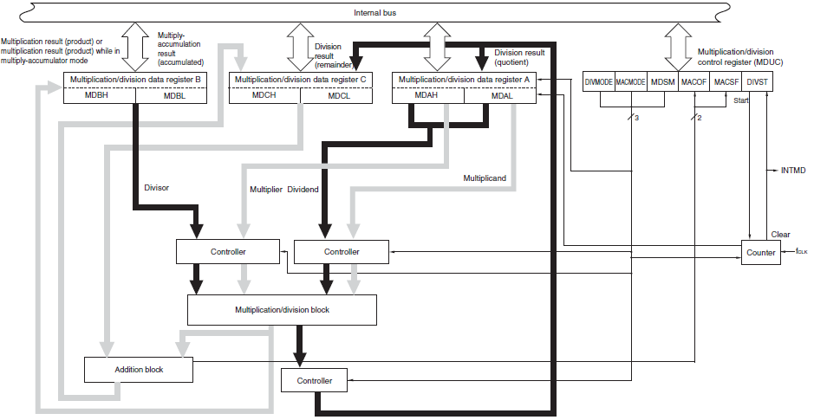
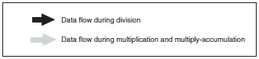
RL78 S2 Core - Block Diagram of Multiplier and Divider/Multiply-Accumulator

Slide 5
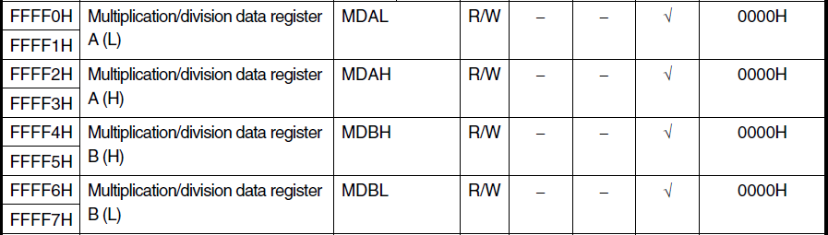
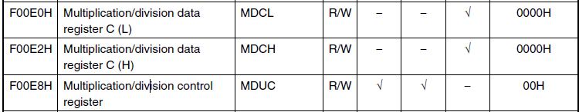
RL78 S2 Core HW Math block registers

Slide 6
HW 16 x 16 unsigned multiply – RL78 S2 MCU Core
Source code:
uint16_t UMULT1 = 0x1234;
uint16_t UMULT2 = 0x9876;
uint32_t UMUL_result = 0x00000000;
UMUL_result = (uint32_t)UMULT1 * (uint32_t)UMULT2;
Assembly code | # of Bytes | CPU Cycles
_COM_lmul: push psw | 2 | 1
di | 3 | 4
clrb !0xf00e8 | 3 | 1
movw 0xffff0, ax | 2 | 1
movw ax, [sp+8] | 2 | 1
movw 0xffff2, ax | 2 | 1
nop | 1 | 1
movw de, !0xffff6 | 3 | 1
movw ax, [sp+6] | 2 | 1
movw 0xffff2, ax | 2 | 1
nop | 1 | 1
movw ax, 0xffff4 | 2 | 1
addw ax, de | 1 | 1
movw de, ax | 1 | 1
movw ax, 0xffff6 | 2 | 1
xchw ax, bc | 1 | 1
movw 0xffff0, ax | 2 | 1
nop | 1 | 1
movw ax, 0xffff6 | 2 | 1
pop psw | 2 | 3
addw ax, de | 1 | 1
xchw ax, bc | 1 | 1
ret | 1 | 6
SUBTOTAL | 40 | 33
Assembly code | # of Bytes | CPU Cycles
push ax | 1 | 1
ei | 3 | 4
movw ax, !0xfef00 <UMULT1> | 3 | 1
push ax | 1 | 1
movw ax, !0xfef02 <UMULT2> | 3 | 1
clrw bc | 1 | 1
call !!0x20c <_COM_lmul> | 4 | 3
movw de, ax | 1 | 1
movw ax, bc | 1 | 1
addw sp, #4 | 2 | 1
movw !0xfef06 <UMUL_result+2>, ax | 3 | 1
movw ax, de | 1 | 1
movw !0xfef04 <UMUL_result>, ax | 3 | 1
SUBTOTAL | 27 | 18
TOTAL (including _COM_Imul: library call) | 67 | 51

Slide 7
HW 16 x 16 signed multiply – RL78 S2 MCU Core
Source code: int16_t SMULT1 = 0x1234; int16_t SMULT2 = 0x9876; int32_t SMUL_result = 0x00000000; SMUL_result = (int32_t)SMULT1 * (int32_t)SMULT2;
Assembly code | # of Bytes | CPU Cycles
_COM_lmul: push psw | 2 | 1
di | 3 | 4
clrb !0xf00e8 | 3 | 1
movw 0xffff0, ax | 2 | 1
movw ax, [sp+8] | 2 | 1
movw 0xffff2, ax | 2 | 1
nop | 1 | 1
movw de, !0xffff6 | 3 | 1
movw ax, [sp+6] | 2 | 1
movw 0xffff2, ax | 2 | 1
nop | 1 | 1
movw ax, 0xffff4 | 2 | 1
addw ax, de | 1 | 1
movw de, ax | 1 | 1
movw ax, 0xffff6 | 2 | 1
xchw ax, bc | 1 | 1
movw 0xffff0, ax | 2 | 1
nop | 1 | 1
movw ax, 0xffff6 | 2 | 1
pop psw | 2 | 3
addw ax, de | 1 | 1
xchw ax, bc | 1 | 1
ret | 1 | 6
SUBTOTAL | 40 | 33
Assembly code | # of Bytes | CPU Cycles
movw ax, !0xfef08 <SMULT1> | 3 | 1
movw bc, ax | 1 | 1
sarw ax, 15 | 2 | 1
push ax | 1 | 1
push bc | 1 | 1
movw ax, !0xfef0a <SMULT2> | 3 | 1
movw de, ax | 1 | 1
sarw ax, 15 | 2 | 1
movw bc, ax | 1 | 1
movw ax, de | 1 | 1
call !!0x20c <_COM_lmul> | 4 | 3
movw de, ax | 1 | 1
movw ax, bc | 1 | 1
addw sp, #4 | 2 | 1
movw !0xfef0e <SMUL_result+2>, ax | 3 | 1
movw ax, de | 1 | 1
movw !0xfef0c <SMUL_result>, ax | 3 | 1
SUBTOTAL | 31 | 19
TOTAL (including _COM_Imul: library call) | 71 | 52

Slide 8
HW 16/16 unsigned divide (with 16bit remainder) – RL78 S2 MCU Core
Assembly code | # of Bytes | CPU Cycles | Branch Not Taken/ Taken
_COM_uidiv: movw de, ax | 1 | 1
clrw ax | 1 | 1
cmpw ax, bc | 1 | 1
bnz $0x23c <_COM_uidiv+8> | 2 | 4 | 2/4
clrw ax | 1 | 1
decw ax | 1 | 1
ret | 1 | 6
movw ax, de | 1 | 1
push psw | 2 | 1
di | 3 | 4
mov !0xf00e8, #128 | 4 | 1
movw 0xffff0, ax | 2 | 1
movw ax, bc | 1 | 1
movw 0xffff6, ax | 2 | 1
clrw ax | 1 | 1
movw 0xffff2, ax | 2 | 1
movw 0xffff4, ax | 2 | 1
mov !0xf00e8, #129 | 4 | 1
mov a, !0xf00e8 | 3 | 1
bt a.0, $0x254 <_COM_uidiv+32> | 3 | 3 | 3/5
movw ax, 0xffff0 | 2 | 1
pop psw | 2 | 3
ret | 1 | 6
SUBTOTAL | 43 | 43
Source Code:
uint16_t U16Divisor = 0x0123;
uint16_t U16Dividend = 0x9876;
uint16_t U16Quotient1 = 0x0000;
U16Quotient1 = U16Dividend / U16Divisor;
Remainder in register:
MDCL: (unsigned) lower 16 bits
Assembly code | # of Bytes | CPU Cycles
movw bc, !0xfef10 <U16Divisor> | 3 | 1
movw ax, !0xfef12 <U16Dividend> | 3 | 1
call !!0x234 <_COM_uidiv> | 4 | 3
movw !0xfef14 <U16Quotient1>, ax | 3 | 1
SUBTOTAL | 13 | 6
TOTAL (including _COM_uidiv: library call) | 56 | 49

Slide 9
Hw 32/32 unsigned divide (with 32bit remainder) – RL78 S2 MCU Core
Assembly code | # of Bytes | CPU Cycles | Branch Not Taken/ Taken
_COM_uldiv: push ax | 1 | 1
movw hl, !0xffff8 | 3 | 1
movw ax, [hl+6] | 2 | 1
or a, x | 2 | 1
or a, [hl+8] | 2 | 1
or a, [hl+9] | 2 | 1
bnz $0x272 <_COM_uldiv+19> | 2 | 4 | 2/4
pop ax | 1 | 1
clrw ax | 1 | 1
decw ax | 1 | 1
movw bc, ax | 1 | 1
ret | 1 | 6
pop ax | 1 | 1
push psw | 2 | 1
di | 3 | 4
mov !0xf00e8, #128 | 4 | 1
movw 0xffff0, ax | 2 | 1
movw ax, bc | 1 | 1
movw 0xffff2, ax | 2 | 1
movw ax, [hl+6] | 2 | 1
movw 0xffff6, ax | 2 | 1
movw ax, [hl+8] | 2 | 1
movw 0xffff4, ax | 2 | 1
mov !0xf00e8, #129 | 4 | 1
mov a, !0xf00e8 | 3 | 1
bt a.0, $0x28d <_COM_uldiv+46> | 3 | 3 | 3/5
movw bc, !0xffff2 | 3 | 1
movw ax, 0xffff0 | 2 | 1
pop psw | 2 | 3
ret | 1 | 6
SUBTOTAL | 60 | 50
Source code:
uint32_t U32Dividend1 = 0x789ABCDE;
uint32_t U32Divisor1 = 0x01234567;
uint32_t U32Quotient1 = 0x00000000;
U32Quotient1 = U32Dividend1 / U32Divisor1;
Assembly code | # of Bytes | CPU Cycles
movw ax, !0xfef1c <U32Divisor1+2> | 3 | 1
push ax | 1 | 1
movw ax, !0xfef1a <U32Divisor1> | 3 | 1
push ax | 1 | 1
movw bc, !0xfef18 <U32Dividend1+2> | 3 | 1
movw ax, !0xfef16 <U32Dividend1> | 3 | 1
call !!0x25f <_COM_uldiv> | 4 | 3
movw de, ax | 1 | 1
movw ax, bc | 1 | 1
addw sp, #4 | 2 | 1
movw !0xfef20 <U32Quotient1+2>, ax | 3 | 1
movw ax, de | 1 | 1
movw !0xfef1e <U32Quotient1>, ax | 3 | 1
SUBTOTAL | 29 | 15
TOTAL (including _COM_uidiv: library call) | 89 | 65
32bit Remainder in registers:
MDCH: (unsigned) higher 16 bits
MDCL: (unsigned) lower 16 bits

Slide 10
RL78 S3 Core native cpu Multiply & Divide instructions

Slide 11
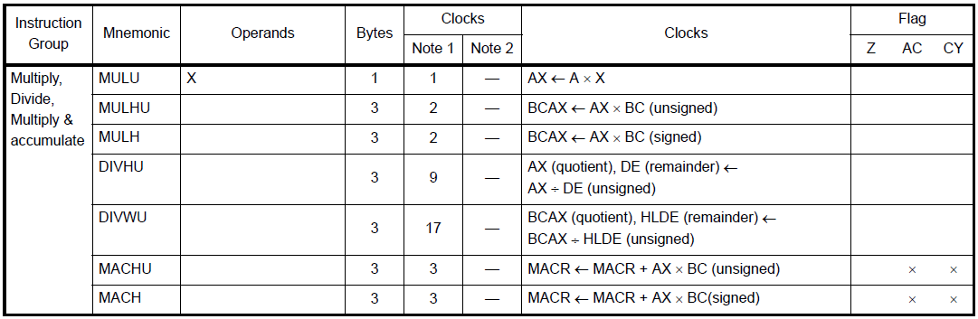
RL78 S3 core – Native CPU Instructions

Slide 12
Native CPU instructions – RL78 S3 MCU Core
16 x 16 unsigned multiply,
16 x 16 signed multiply
CPU 16 x 16 unsigned multiply
Source code:
uint16_t UMULT1 = 0x1234;
uint16_t UMULT2 = 0x9876;
uint32_t UMUL_result = 0x00000000;
UMUL_result = (uint32_t)UMULT1 * (uint32_t)UMULT2;
CPU 16 x 16 signed multiply
Source code:
int16_t SMULT1 = 0x1234;
int16_t SMULT2 = 0x9876;
int32_t SMUL_result = 0x00000000;
SMUL_result = (int32_t)SMULT1 * (int32_t)SMULT2;
Assembly code | # of Bytes | CPU Cycles
movw bc, !0xfa300 <UMULT1> | 3 | 1
movw ax, !0xfa302 <UMULT2> | 3 | 1
mulhu | 3 | 2
movw !0xfa304 <UMUL_result>, ax | 3 | 1
movw ax, bc | 1 | 1
movw !0xfa306 <UMUL_result+2>, ax | 3 | 1
TOTAL | 16 | 7
Assembly code | # of Bytes | CPU Cycles
movw bc, !0xfa308 <SMULT1> | 3 | 1
movw ax, !0xfa30a <SMULT2> | 3 | 1
mulh | 3 | 2
movw !0xfa30c <SMUL_result>, ax | 3 | 1
movw ax, bc | 1 | 1
movw !0xfa30e <SMUL_result+2>, ax | 3 | 1
TOTAL | 16 | 7

Slide 13
Native CPU instructions– RL78 S3 MCU Core
16 / 16 unsigned divide (with 16bit remainder),
32 / 32 unsigned divide (with 32bit remainder)
CPU 16 / 16 unsigned divide
Source code:
int16_t SMULT1 = 0x1234;
int16_t SMULT2 = 0x9876;
int32_t SMUL_result = 0x00000000;
U16Quotient1 = U16Dividend / 16Divisor;
CPU 32 / 32 unsigned divide
Source code:
uint32_t U32Dividend1 = 0x789ABCDE;
uint32_t U32Divisor1 = 0x01234567;
uint32_t U32Quotient1 = 0x00000000;
U32Quotient1 = U32Dividend1 / U32Divisor1;
Assembly code | # of Bytes | CPU Cycles
movw de, !0xfa310 <U16Divisor> | 3 | 1
movw ax, !0xfa312 <U16Dividend> | 3 | 1
divhu | 3 | 9
nop | 1 | 1
movw !0xfa314 <U16Quotient1>, ax | 3 | 1
TOTAL | 13 | 13
Assembly code | # of Bytes | CPU Cycles
movw hl, !0xfa31c <U32Divisor1+2> | 3 | 1
movw de, !0xfa31a <U32Divisor1> | 3 | 1
movw bc, !0xfa318 <U32Dividend1+2> | 3 | 1
movw ax, !0xfa316 <U32Dividend1> | 3 | 1
divwu | 3 | 17
nop | 1 | 1
movw !0xfa31e <U32Quotient1>, ax | 3 | 1
movw ax, bc | 1 | 1
movw !0xfa320 <U32Quotient1+2>, ax | 3 | 1
TOTAL | 23 | 25
Note:
16bit remainder in registers DE
32bit remainder in registers HLDE

Slide 14
Renesas.com

